Slide 1
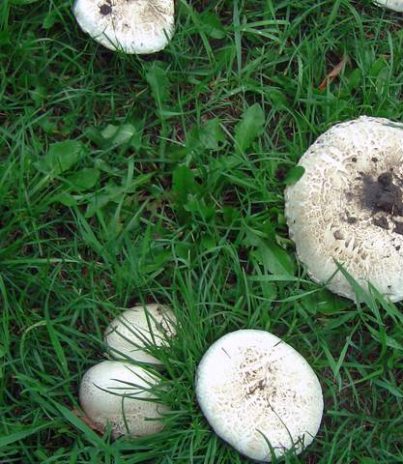
Group 4 IST 707 Mushroom Edibility Classification
Poisonous or Edible?

Slide 2
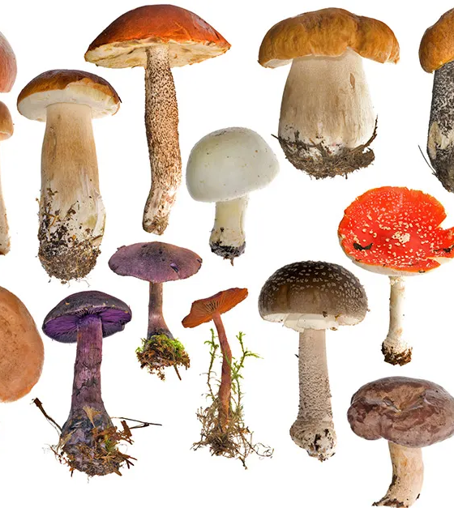
Defining Mushrooms
Let’s Introduce mushrooms overall;
“Mushrooms” are part of a highly varied collection of organisms known as the Fungi Kingdom
The “Mushroom” you see is the reproductive fruit of a larger organism
Mushroom’s fruit are usually only present for a few days, which makes them incredibly rare in the fossil record.
Most mushrooms have a stalk, and cap, but many other varieties occur globally.

Slide 3
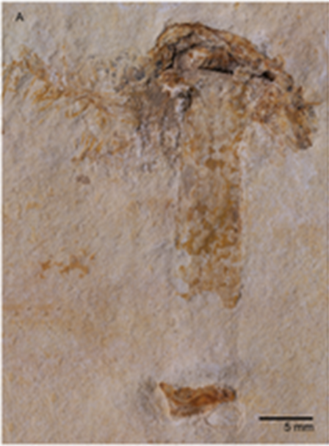
One of the Oldest Mushroom Fossils
Specimen shown left found in Chapado de Agaripe , in Cerea Brazil.
Rare preservation in a Lagerstätten”, a fossil rich deposit, dating 115 b.y.a.
Mushrooms do not fruit for more than a few days, so fossil records are sparse.
Many of the same features as modern mushrooms are present (Lamella, veil, stipe, and ring.)

Slide 4
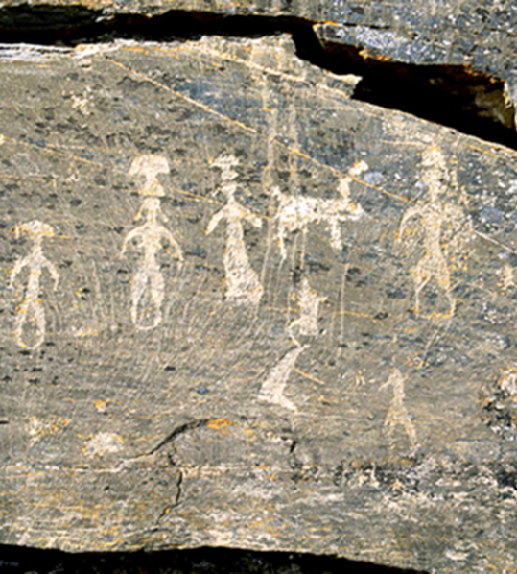

Ancient Humans & Mushrooms
Ethnomycology is the study of humankind’s usage and conception of mushrooms in culture throughout history.
(Left) Siberia 1. C.E. , Ancient whaling people depict Mushrooms on their heads
Thought that psychoactive mushrooms were a ritualistic part of their culture

Slide 5
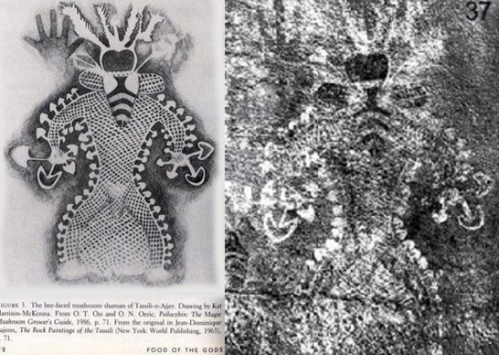
Ancient Humans & Mushrooms
Most famous example from Algeria,

Slide 6
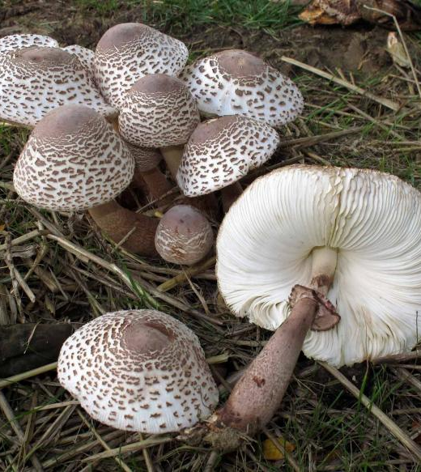
Context
Qualifications of the study:
Vastly different mushroom species are incredibly similar in their physiology
General variation in fruiting bodies of one mushrooms occur based on their environment
Spore print combined with physiology is sometimes the only way to place an identity of a mushroom, and even then, some are still almost impossible to tell apart.

Slide 7
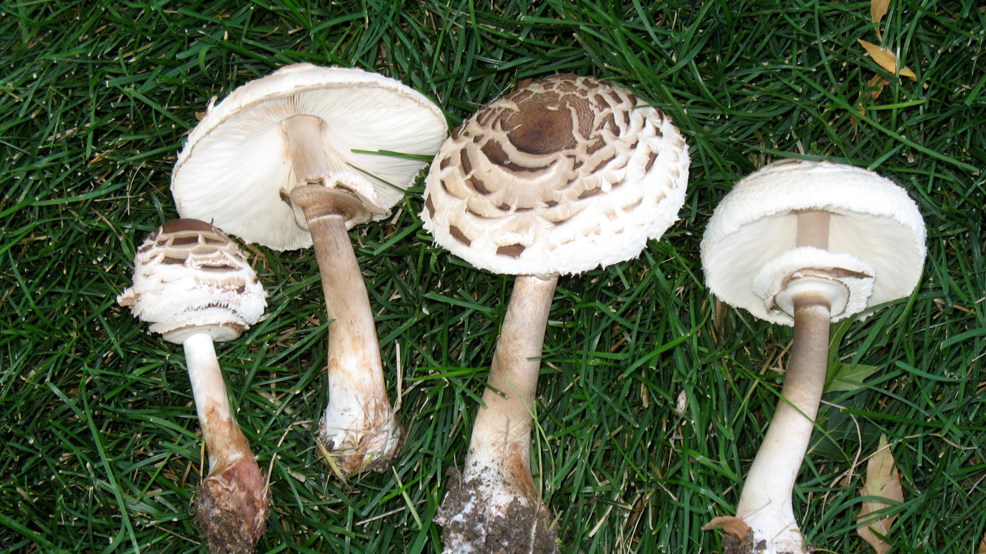
Data Context
This dataset presents a difficult classification problem of a predicting a mushrooms edibility based on features.
Data is on 23 species of Lepiota and Agaricus family mushrooms ( no species category is provided with the data)
Of the 22 features, some are (bruises?, odor, stalk-shape, gill-attachment, spore-print-color, population, and habitat)
All 22 features are coded as single letters representing a category of the feature.
There is no missing / NA information in the 8125 rows of data
The data was acquired from https://www.kaggle.com/datasets/uciml/mushroom-classification?resource=download

Slide 8
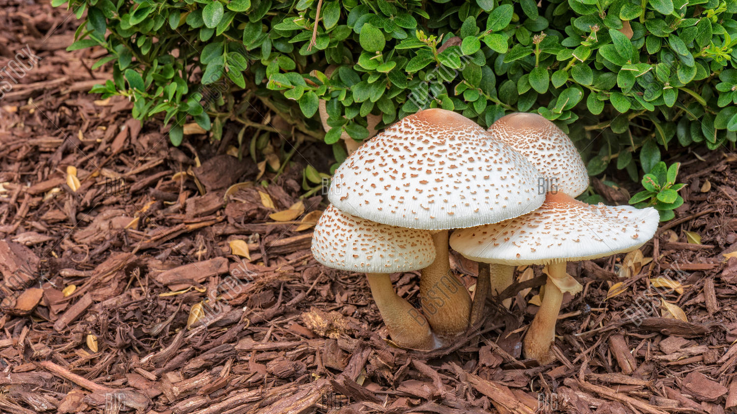
Data Pre-Processing
Our group will need to format the data properly to perform several different techniques in order to compare how well data-mining methods can predict mushroom edibility.
This will involve storing all “chr” coded features as factors, and storing and removing the labels of ( poisonous or edible ) from initial test data.
Otherwise, this is a relatively clean dataset to begin working with

Slide 9
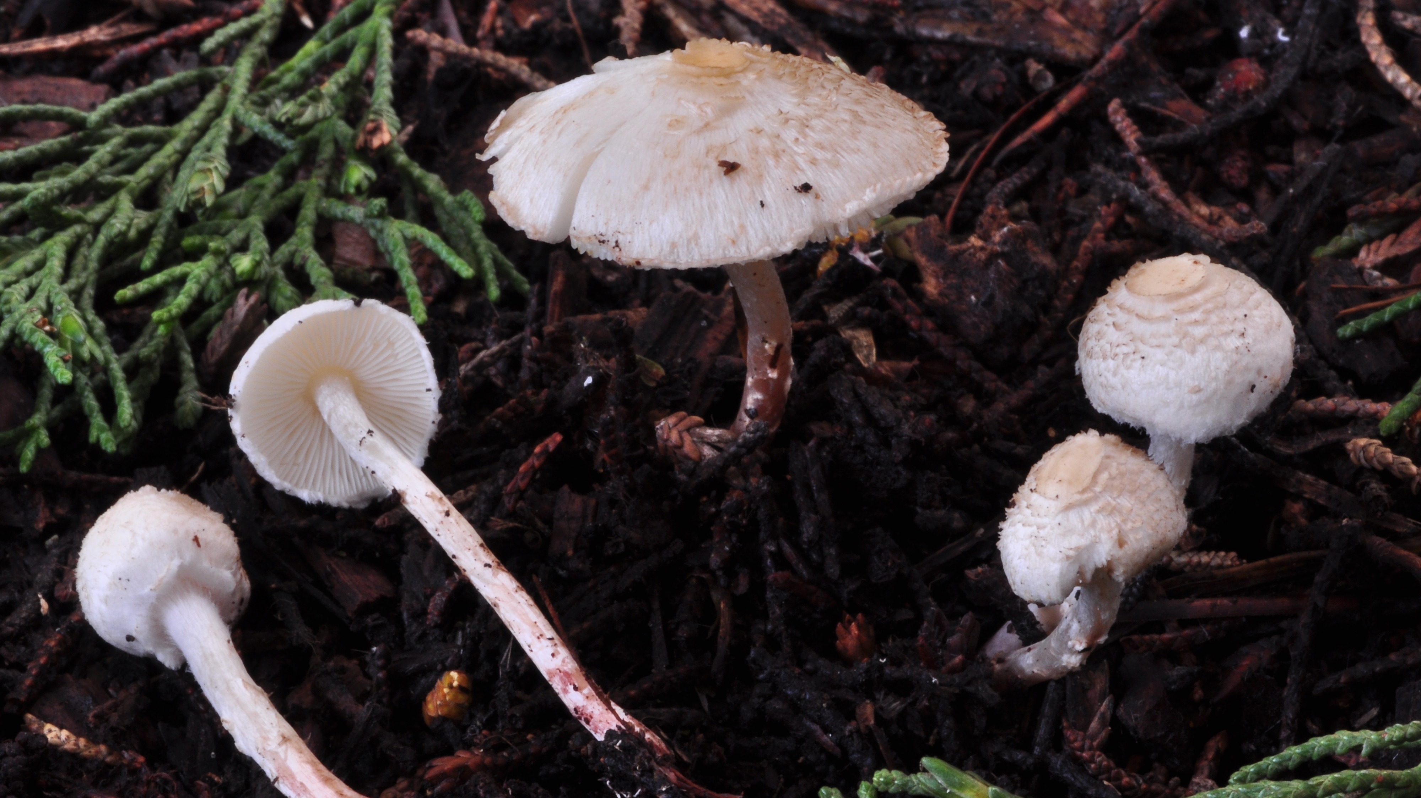
Exploratory Analysis
Summary statistics of dataset
Visualizations of occurrences of features (histograms, distributions)
Highlight Popular features, mixed bags, and frequencies
Analyze the ratio of Poisonous to Edible mushrooms
Choose Divisions for Training and Testing datasets

Slide 10
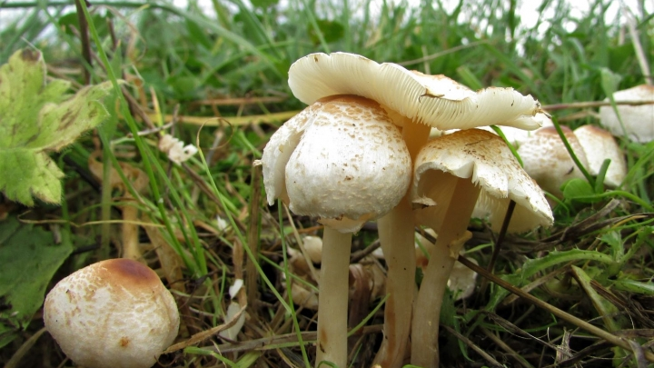
Data – Mining Techniques
We plan to perform comparisons of error rates of confusion matrixes using
K-means algorithm clustering
Hierarchical clustering
Association Rule Mining
Decision Tree algorithm partitioning

Slide 11
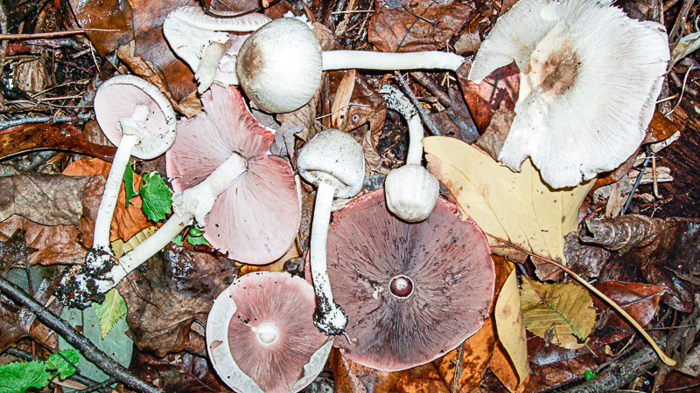
Comparison of Techniques
Confusion Matrices will be generated to evaluate the accuracy of the different techniques employed
We will use the matrices to investigate overfitting of the data

Slide 12
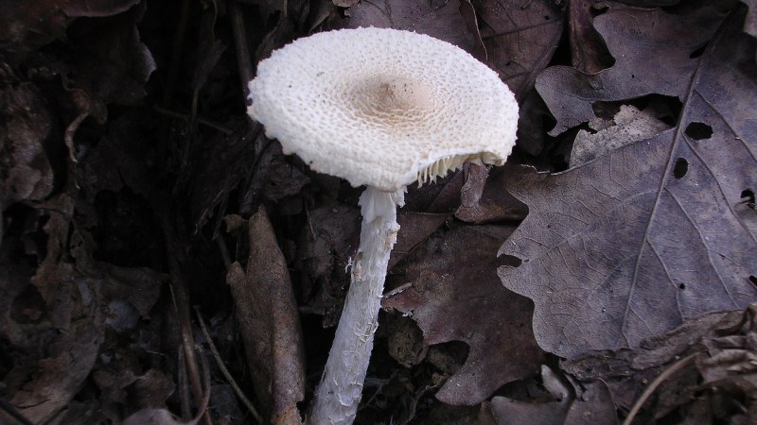
Conclusion
The most effective technique / combination of data mining techniques will be presented.
Interpreting the models combined accuracy will be used to assess how well data – mining can be applied to this problem domain.
Questions that arise from the results will be posed at the end of our presentation.

